Slide 1


Slide 2
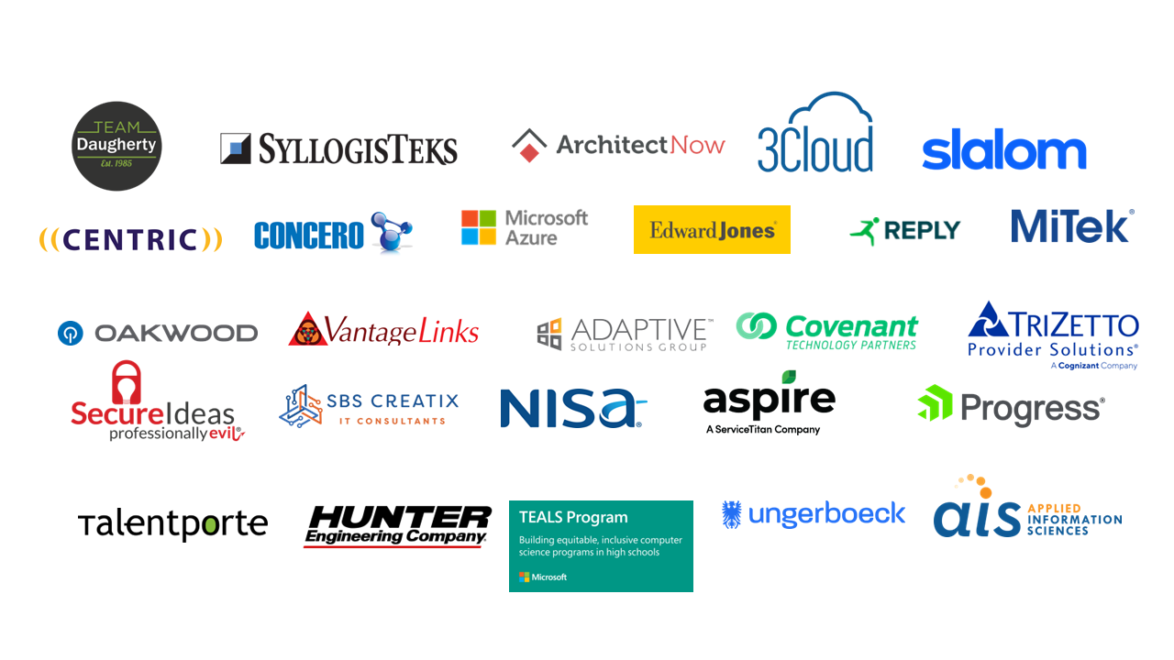

Slide 3
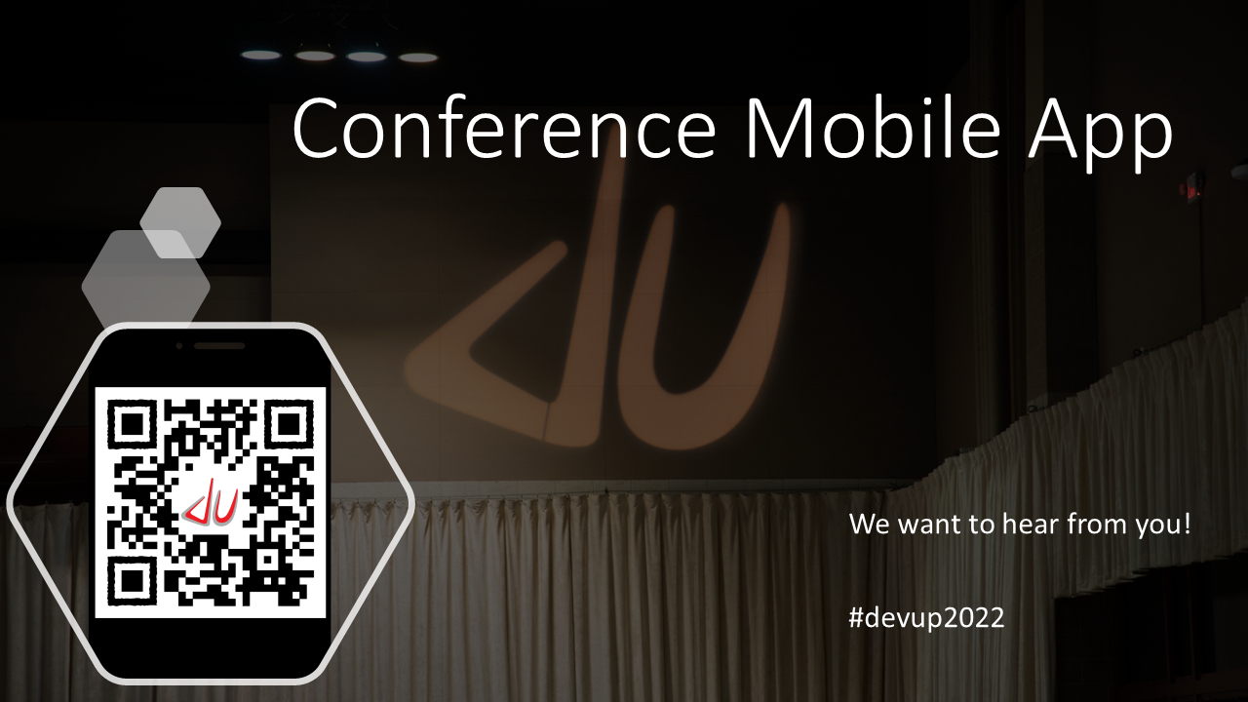

Slide 4






Who is Chad Green
chadgreen@chadgreen.com
TaleLearnCode
ChadGreen.com
ChadGreen & TaleLearnCode
ChadwickEGreen

Slide 5




August 17 – 19, 2022
Keynote – Christina Aldan
.NET Rocks! 20th Anniversary Party
A Toast to Women in Technology

Slide 6

Notes:
The Taming of the Shrew is a Shakespeare comedy depicting the courtship of Petruchio and Katherina, the headstrong, obdurate shrew. Initially, Katherina is an unwilling participant in the relationship; however Petruchio “tames” here with various psychological and physical torments, such as keeping here from eating and drinking, until she becomes a desirable, compliant, and obedient bride.

Slide 7



Notes:
The Taming of the Shrew has been adapted numerous times for stage, screen, opera, ballet, and musical theater; perhaps the most famous adaptations being Cole Porter’s Kiss Me Kate; McLintock! a 1963 American Western comedy film staring John Wayne and Maureen O’Hara; and the 1967 file of the play, starring Elizabeth Taylor and Richard Burton. The 1999 high-school comedy film 10 Things I Hate About You, and the 2003 romantic comedy deliver Us from Eva are also loosely based on the play.

Slide 8

No profit grows where is no pleasure ta'en. In brief, sir, study what you most affect

Slide 9

What’s the problem?
Jokes
Famous
Quotes
Movie
Quotes
Inspiration
Quotes
Chuck
Norris
Facts
Who
What
When
Where
Why
How
Notes:
Who has the APIs I need
What are the APIs that are available
When can I use the APIs
Where are the endpoints
Why should I use your API
How do I use the APIs

Slide 10
What’s the problem?
Jokes
Famous
Quotes
Movie
Quotes
Inspiration
Quotes
Chuck
Norris
Facts
Who
What
When
Where
Why
How
Notes:
Who has the APIs I need
What are the APIs that are available
When can I use the APIs
Where are the endpoints
Why should I use your API
How do I use the APIs

Slide 11


What’s the problem?
Who
Mobile App
Web App
External System
What
When
Where
Account
Service
Book
Service
Order
Service
Shipping
Service
Why
How
Account DB
Inventory DB
Order DB
Shipping DB
Notes:
Who has the APIs I need
What are the APIs that are available
When can I use the APIs
Where are the endpoints
Why should I use your API
How do I use the APIs

Slide 12

If I be waspish, best beware my sting.

Slide 13
API Management Basics

Slide 14
What is API Management?
Creating
API Connections
Publishing
API Connections
Managing
API Connections
Notes:
API management refers to the process of creating, publishing, and managing API connections in a secure and scalable environment. The goals of API management is to ensure that the needs of developers and applications that may use the APIs are being met.
API management is more than just a place for API connections to live. And while API management needs will differ from organization to organization, [CLICK] there are several pieces of functionality generally common with API management systems:

Slide 15
What is API Management?
Creating
API Connections
Publishing
API Connections
Managing
API Connections
Notes:
there are several pieces of functionality generally common with API management systems:

Slide 16
What is API Management?
Creating and Publishing APIs
Enforcing Usage Policies
Controlling Access
Nurturing Developer Community
Tracking Usage
Performance Reporting
Notes:
there are several pieces of functionality generally common with API management systems:
Creating and publishing APIs
Enforcing their usage policies
Controlling access
Nurturing the developer community
Collecting and analyzing usage statistics
Reporting on performance

Slide 17
API Management Benefits
Data-Driven Decisions
Notes:
Ability to Make Data-Driven Decisions
The ability to make data-driven decisions through business insights gained from API analytics

Slide 18
API Management Benefits
Data-Driven Decisions
Data-Driven Decisions
Security Threat Protection
Notes:
Next: Protection of the organization from security threats that affect APIs

Slide 19
API Management Benefits
Data-Driven Decisions
Security Threat Protection
Notes:
Protection of the organization from security threats that affect APIs

Slide 20
API Management Benefits
Data-Driven Decisions
Security Threat Protection
Security Threat Protection
Documentation
Notes:
Next; Documentation

Slide 21
API Management Benefits
Data-Driven Decisions
Security Threat Protection
Documentation
Notes:
Documentation
The ability to produce detailed API documentation that can be used to attract developers and inform users

Slide 22
API Management Benefits
Data-Driven Decisions
Security Threat Protection
Documentation
Documentation
Centralized Visibility
Notes:
Next: Centralized Visibility

Slide 23
API Management Benefits
Data-Driven Decisions
Security Threat Protection
Documentation
Centralized Visibility
Notes:
Centralized Visibility
Centralized visibility that allows organizations to see their API connections in one place, thus reducing security vulnerabilities, decreasing the number of repetitive APIs and identifying gaps for developers to address

Slide 24
API Management Benefits
Data-Driven Decisions
Security Threat Protection
Documentation
Centralized Visibility
Centralized Visibility
Monetization
Notes:
Next: Monetization

Slide 25
API Management Benefits
Data-Driven Decisions
Security Threat Protection
Documentation
Centralized Visibility
Monetization
Notes:
Monetization
The ability to monetize PAIs, share revenue with partners, and track billing in real time.

Slide 26
API Management Benefits
Data-Driven Decisions
Security Threat Protection
Documentation
Centralized Visibility
Monetization
Positive User Experience
Monetization
Notes:
Next: Positive User Experience

Slide 27
API Management Benefits
Data-Driven Decisions
Security Threat Protection
Documentation
Centralized Visibility
Positive User Experience
Monetization
Notes:
Positive User Experience
Creation of a positive user experience for API consumers

Slide 28
API Management Benefits
Data-Driven Decisions
Security Threat Protection
Documentation
Centralized Visibility
Positive User Experience
Agile Ecosystem
Monetization
Positive User Experience
Notes:
Next: Agile Ecosystem

Slide 29
API Management Benefits
Data-Driven Decisions
Security Threat Protection
Documentation
Centralized Visibility
Agile Ecosystem
Monetization
Positive User Experience
Notes:
Agile Ecosystem
The ability to create a flexible, agile, adaptable, and innovative ecosystem in which all people, processes, and technologies can work together
Improvements in API agility and the ability to rapidly create new digital assets

Slide 30
API Management Benefits
Data-Driven Decisions
Security Threat Protection
Documentation
Centralized Visibility
Agile Ecosystem
Optimized Value
Monetization
Positive User Experience
Agile Ecosystem
Notes:
Next: Optimized Value

Slide 31
API Management Benefits
Data-Driven Decisions
Security Threat Protection
Documentation
Centralized Visibility
Optimized Value
Monetization
Positive User Experience
Agile Ecosystem
Notes:
Optimized Value
API management enables an organization to optimize the value of its existing legacy systems by updating outdated security protocols so they match the modern standard used by today’s APIs. API management software can also translate complex data from the legacy systems into easier message formats. Furthermore, API management can be used to combine all back-end services into one functionality that is exposed as an API.

Slide 32
API Management Benefits
Data-Driven Decisions
Data-Driven Decisions
Security Threat Protection
Security Threat Protection
Documentation
Documentation
Centralized Visibility
Centralized Visibility
Agile Ecosystem
Monetization
Monetization
Positive User Experience
Positive User Experience
Agile Ecosystem
Agile Ecosystem
Optimized Value
Optimized Value

Slide 33
API Management Benefits
Data-Driven Decisions
Security Threat Protection
Documentation
Centralized Visibility
Monetization
Positive User Experience
Agile Ecosystem
Optimized Value

Slide 34

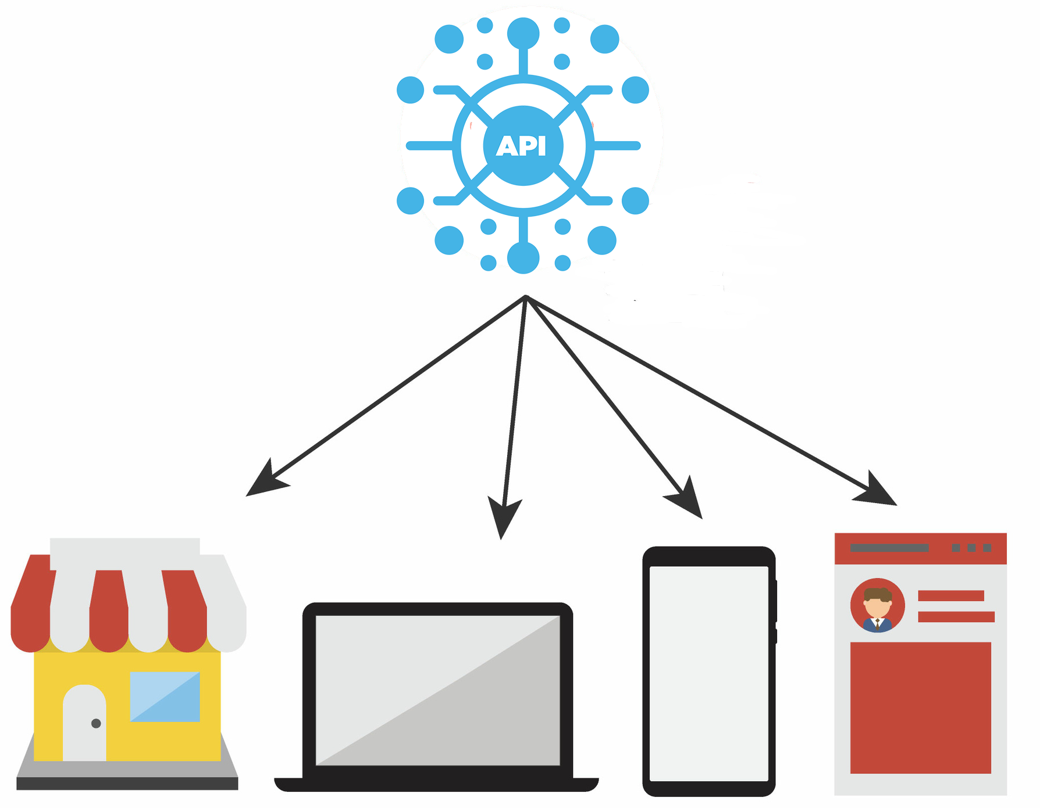

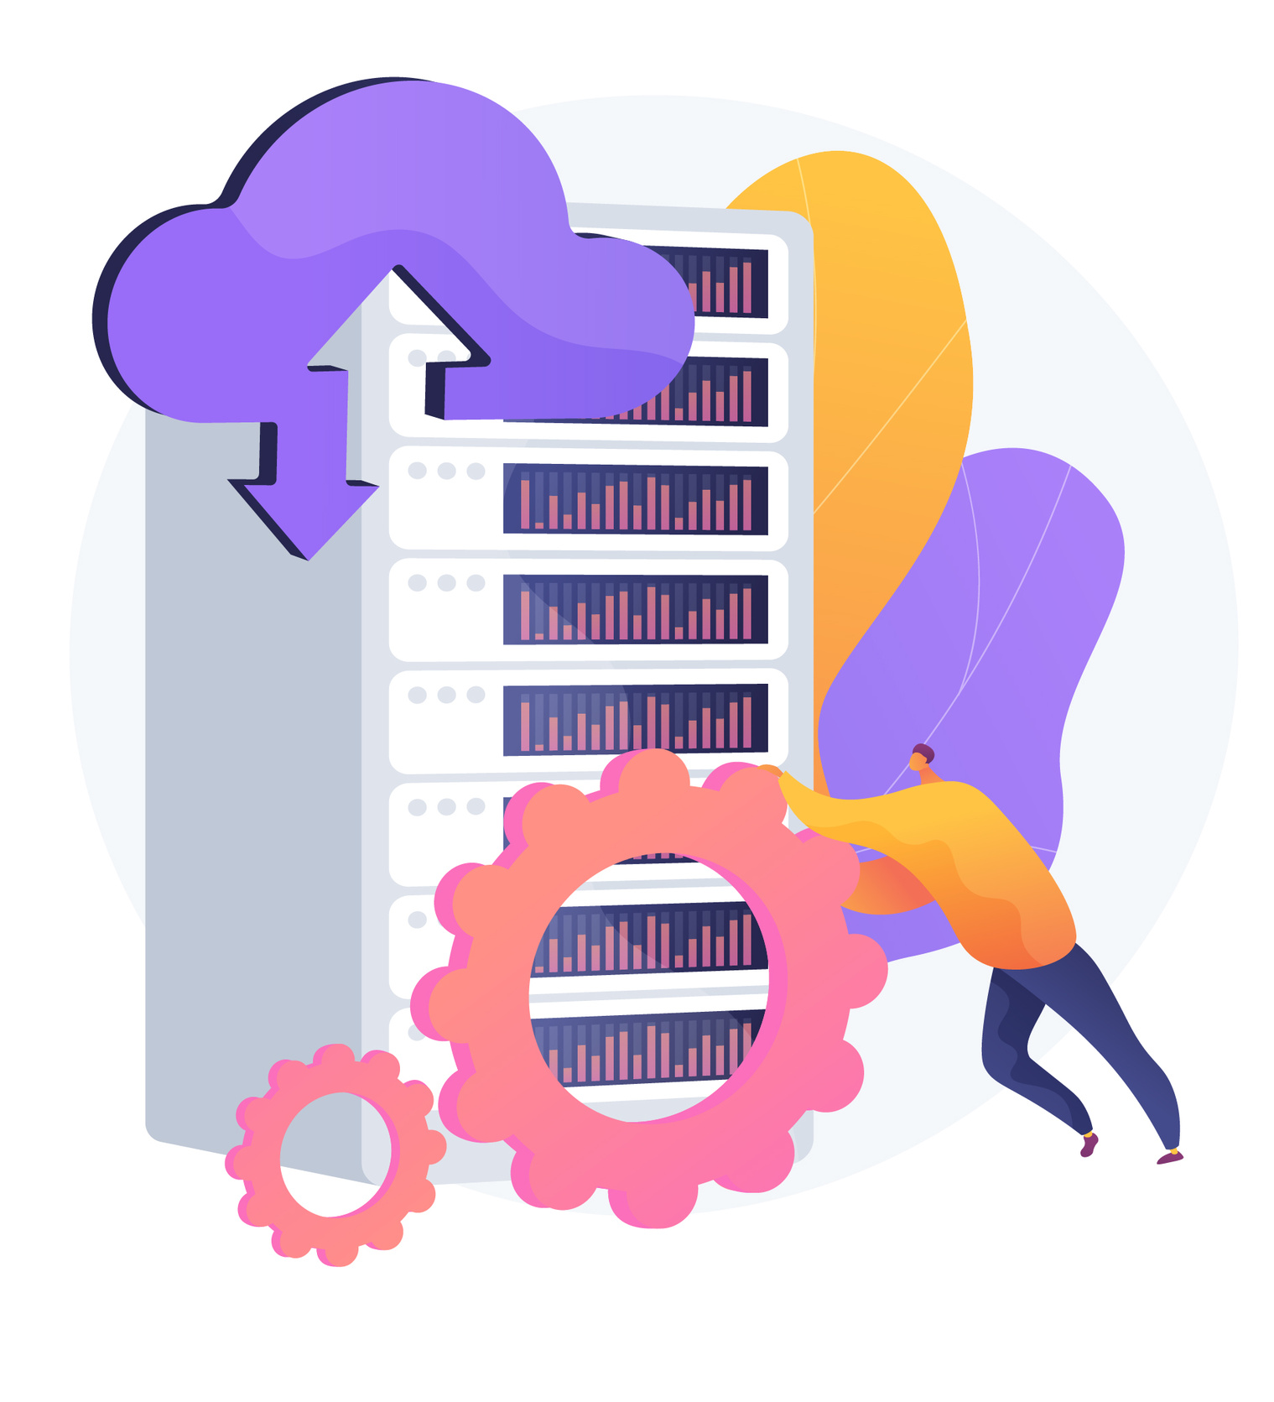

API Management Use Cases
API Integration
Multi-Channel
User Experiences
B2B Integration
Data as a Service
Unlocking
Legacy Assets
API Integration
Notes:
API Integration
API integration is the process of connecting two or more applications via their APIs to perform a joint function. The connection is made through the API layer of each application to make them talk to one another. API integration ensures that applications which are connected represent the most up-to-date data while providing data integrity across a technology stack without having to worry about versioning. Some API management solutions come pre-installed with out-of-the-box integrations, while other require more complex integrations.

Slide 35
API Management Use Cases
API Integration
Multi-Channel
User Experiences
B2B Integration
Data as a Service
Unlocking
Legacy Assets
Multi-Channel User Experiences
Notes:
Multi-Channel User Experiences
APIs are frequently used to enable user experiences such as web, mobile, wearable, or IoT applications. Reuse APIs to accelerate development and ROI.

Slide 36
API Management Use Cases
API Integration
Multi-Channel
User Experiences
B2B Integration
Data as a Service
Unlocking
Legacy Assets
B2B Integration
Notes:
B2B Integration
APIs exposed to partners and customers lower the barrier to integrate business processes and exchange data between business entities. APIs eliminate the overhead inherent in point-to-point integration.
B2B integration, refers to the automation of communication and business processes of two or more organization. This integration delivery style enables them to work more effectively with customers, suppliers, and business partners through business process automation.
B2B integration pulls information form an internal source application and transfers it to an end external application via secure data movement and an integration platform.

Slide 37
API Management Use Cases
API Integration
Multi-Channel
User Experiences
B2B Integration
Data as a Service
Unlocking
Legacy Assets
Data as a Service
Notes:
Data as a Service
Data as a Service is a type of data management strategy that uses the cloud to deliver data storage, integration, processing, or analytic services via a network connection. DaaS tools remove the need for organizations to install and manage software or hardware locally. DaaS allows organizations to begin storing and processing data quickly, and can be more scalable than on-prem alternatives since more users can be allocated to cloud workloads. DaaS tools are usually managed automatically and kept up-to-date by the provider.

Slide 38
API Management Use Cases
API Integration
Multi-Channel
User Experiences
B2B Integration
Data as a Service
Unlocking
Legacy Assets
Unlocking Legacy Assets
Notes:
Unlocking Legacy Assets
APIs are used to abstract and modernize legacy backends and make them accessible from new cloud services and modern applications. APIs allow innovation without the risk, cost, and delays of migration.

Slide 39
API Management Use Cases
API Integration
Multi-Channel
User Experiences
B2B Integration
Data as a Service
Unlocking
Legacy Assets

Slide 40
API Management Components
Gateway
Notes:
API Gateway
An API gateway is the most important aspect of an API management solution and acts as the gateway to connected systems and services. API gateways handle all routing requests, composition, and protocol translations between clients and the third-party services they are connected to. API gateways play a crucial component in ensuring the security of API connections by deploying key security authentication and enforcement protocols, including TLS encryption and OAuth technology standards. The API gateway also allows developers to easily consume microservices as managed APIs.

Slide 41
API Management Components
Gateway
Gateway
Policy Manager
Notes:
API Policy Manager
The API policy manager controls the lifecycle of policies used to define and manage the API. API policies will follow the same journey as an API, from design through retirement. Many API management platforms provide users with out-of-the-box policies that control API traffic, enhance security, improve performance, and increase the value of the API. These policies can be implemented without writing code or modifying back-end services.

Slide 42
API Management Components
Gateway
Policy Manager
Policy Manager
Developer Portal
Notes:
API Developer Portal
An API developer portal services a variety of purposes, but its primary benefit is to provide a self-service hub for developers to access and share API documentation. Developer portals are an integral part of streamling communication between teams and make it possible for developers to easily browse, build, and test their APIs.

Slide 43
API Management Components
Gateway
Policy Manager
Developer Portal
Developer Portal
Reporting and Analytics
Notes:
Reporting and Analytics
Another critical aspect of API management solutions is that they allow organizations to track usage metrics in a variety of ways. API platforms use a synthetic approach to monitoring an API’s response time, availability, and overall performance. API platforms can also integrate analytics programs and use protocols designed to extract data for automated and reporting and analysis over time. These analytics tools play a key role in diagnosing and troubleshooting integration issues that may arise and help enterprises make better-informed decisions about their applications and services.

Slide 44
API Management Components
Gateway
Policy Manager
Developer Portal
Reporting and Analytics
Lifecycle Management
Reporting and Analytics
Notes:
API Lifecycle Management
API integrations make up a critical piece of digital transformation strategies and are an essential part of helping organizations scale their operations. API management platforms benefit enterprises by allowing them to manage the entire lifecycle of their APIs, from their initial creation through all of their development stages and inevitable retirement. API management provides a sustainable solution for building, testing, onboarding, and managing APIs while ensuring adequate version control every step of the way.

Slide 45
API Management Components
Gateway
Policy Manager
Developer Portal
Lifecycle Management
Monetization
Reporting and Analytics
Lifecycle Management
Notes:
Support for API Monetization
Monetize access to the microservices behind the APIs through usage contracts. API management allows you to define usage contracts based on metrics, like the number of API calls. Consumers can be segmented and differentiated access tiers, and service quality can be offered to different segments.

Slide 46
API Management Components
Gateway
Policy Manager
Developer Portal
Gateway
Policy Manager
Developer Portal
Monetization
Reporting and Analytics
Lifecycle Management
Monetization
Reporting and Analytics
Lifecycle Management
Monetization

Slide 47
API Management Components
Gateway
Policy Manager
Developer Portal
Reporting and Analytics
Lifecycle Management
Monetization

Slide 48
API Management Marketplace

Slide 49

There’s small choice in rotten apples

Slide 50














API Management Offerings

Slide 51
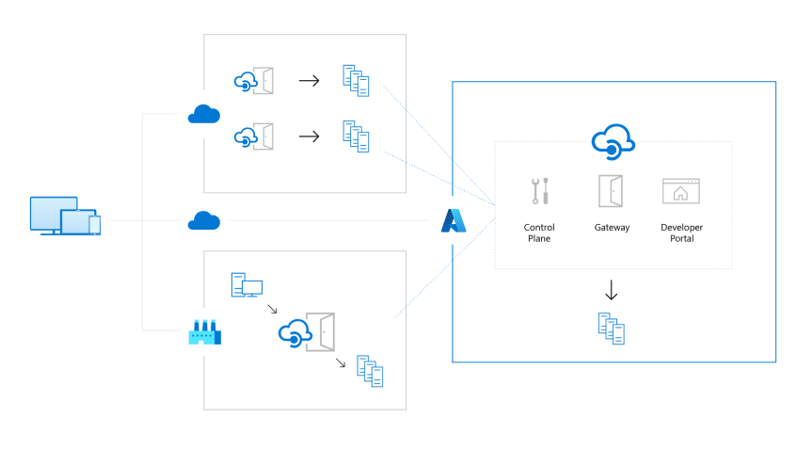
Azure API Management
Manage APIs across clouds and on-premises
Notes:
Manage APIs across clouds and on-premises
Deploy API gateways side-by-side with the APIs hosted in Azure, other clouds, and on-premises, optimizing API traffic flow. Meet security and compliance requirements while enjoying a unified management experience and full observability across all internal and external APIs.

Slide 52
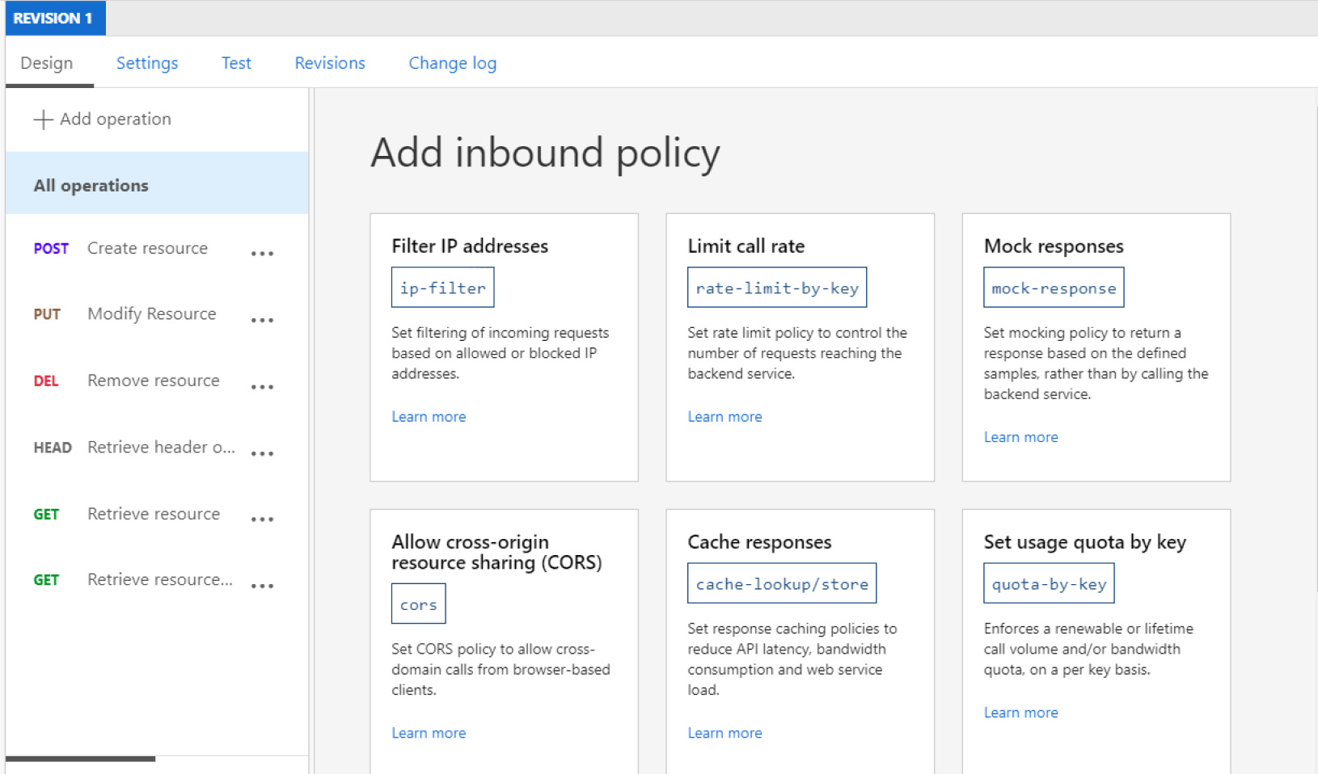
Azure API Management
Help protect your resources
Notes:
Help protect your resources
Control how data and services are exposed to employees, partners, and customers by applying authentication, authorization, and usage limits.

Slide 53
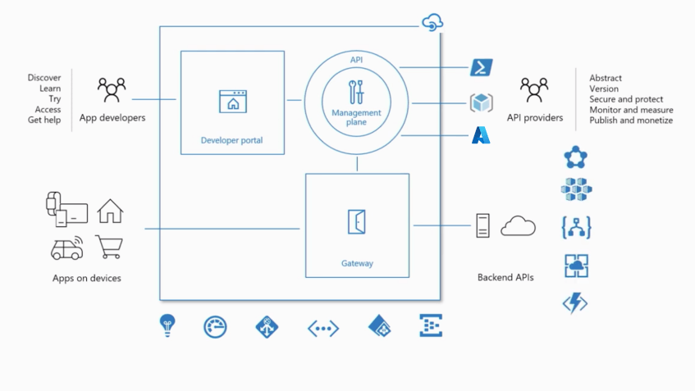
Azure API Management
Accelerate your business
Notes:
Accelerate your business
Build apps faster and deliver immediate value to your customers through API-first approaches. Decouple front- and back-end teams through API mocking, API revisions and versioning, and automated API documentation.

Slide 54
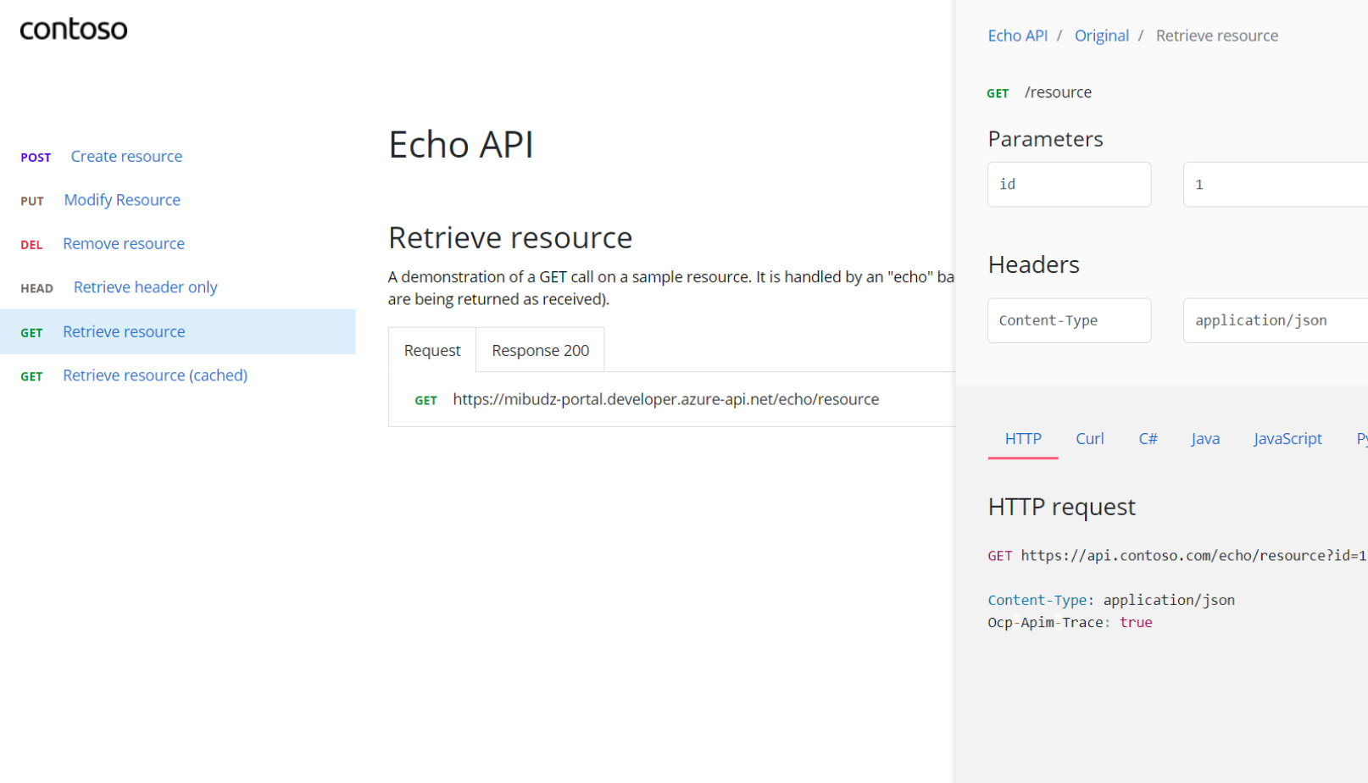
Azure API Management
Improve API discoverability
Notes:
Improve API discoverability
Create a customizable developer portal for all your APIs. Easily manage and share APIs with internal teams, external partners, and customers.

Slide 55
Azure API Management
Transform your existing services
Notes:
Transform your existing services
Automatically turn legacy web services into modern REST-based APIs by creating façades for your back-end services. See how innovators like Vipps, a leading payment service in Norway, are revolutionizing development using Azure API Management.

Slide 56
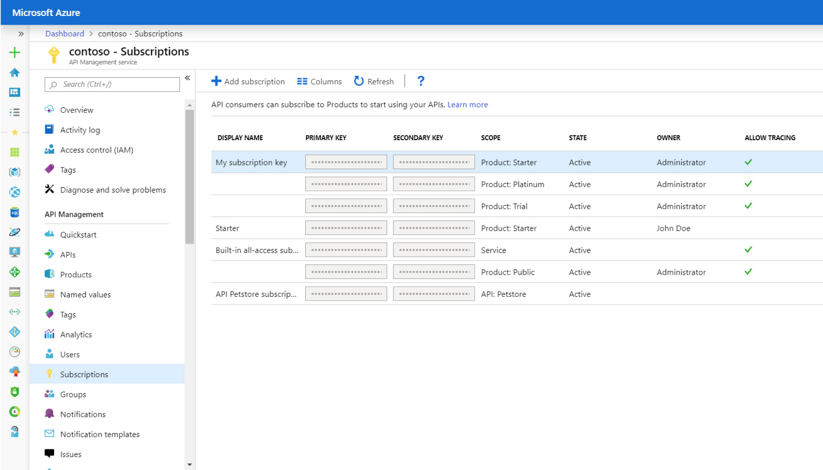
Azure API Management
Transform your existing services
Notes:
Help secure your APIs
Keep all your APIs behind a single static IP or domain, and help protect them with keys, tokens, and IP filtering.
Enforce flexible and fine-grained quotas and rate limits. Modify the shape and behavior of your APIs using policies. Improve latency and scale your APIs with response caching.
Connect on-premises APIs to cloud services by creating a façade that lets you safely integrate on-premises and cloud environments.

Slide 57
Tiers & Pricing
Basic
Standard
Premium
Developer
Consumption
Isolated
Notes:
Basic – Entry-level production use cases
Standard – Medium-volume production use cases
Premium – High-volume or enterprise production use cases
Developer – Non-production use cases and evaluations
Consumption – Lightweight and serverless version of API Management services, billed per execution
Isolated – Enterprise production use cases requiring high degree of isolation

Slide 58
Tiers & Pricing
 | Consumption | Developer | Basic | Standard | Premium | Isolated
Price | $0.035/10k | $48.04 | $147.17 | $686.72 | $2795.17 | TBA
Cache | External Only | 10-Mb | 50-Mb | 1-Gb | 5-Gb | 5-Gb
Scale-Out | N/A | 1 | 2 | 4 | 12/region | 12/region
SLA | 99.95% | No | 99.95% | 99.95% | 99.99% | 99.99%
Isolation | Shared | Private | Private | Private | Private | Private
Developer Portal | No | Yes | Yes | Yes | Yes | Yes
Azure AD Integration | No | Yes | No | Yes | Yes | Yes
Virtual Network | No | Yes | No | No | Yes | Yes
Multi-Region Deployment | No | No | No | No | Yes | Yes
Self-Hosted Gateway | No | Yes | No | No | Yes | Yes
Max Throughput | N/A | 500 | 1,000 | 2,500 | 4,000 | 4,000
Compute Isolation | No | No | No | No | No | Yes
Consumption
Developer
External Only
N/A
No
No
Yes
Yes
Yes
Yes
N/A

Slide 59

‘Tis hatched, and shall be so.

Slide 60
API Management Demonstration

Slide 61

Notes:
Senior Living Systems provides cloud-based software solutions for companies that operate senior living communities. The focus is to help these operators manage their portfolios, residents, and the care they provide to those residents using highly-efficient software systems.

Slide 62
Notes:
Senior Living Systems provides cloud-based software solutions for companies that operate senior living communities. The focus is to help these operators manage their portfolios, residents, and the care they provide to those residents using highly-efficient software systems.

Slide 63
Portfolio Management
Resident Management
Care Management
Lease Management
PM
RM
CM
LM
PM External API
RM External API
CM External API
LM External API
API Management
Customer Portfolio Management
Customer Resident Management
Customer Care Management
Customer Lease Management

Slide 64
Portfolio Management
Resident Management
Care Management
Lease Management
PM
RM
CM
LM
PM External API
RM External API
CM External API
LM External API
API Management
Customer Portfolio Management
Customer Resident Management
Customer Care Management
Customer Lease Management

Slide 65
Portfolio Management
Resident Management
Care Management
Lease Management
PM
RM
CM
LM
PM Listing Services
PM External API
RM External API
CM External API
LM External API
API Management
Customer Marketing Sites
Customer Portfolio Management
Customer Resident Management
Customer Care Management
Customer Lease Management

Slide 67
Portfolio Management
Resident Management
Care Management
Lease Management
PM
RM
CM
LM
PM Listing Services
PM External API
RM External API
CM External API
LM External API
API Management
Customer Marketing Sites
Customer Portfolio Management
Customer Resident Management
Customer Care Management
Customer Lease Management

Slide 68
Portfolio Management
Resident Management
Care Management
Lease Management
PM
RM
CM
LM
PM Listing Services
PM External API
RM External API
CM External API
LM External API
API Management
Customer Marketing Sites
Customer Portfolio Management
Customer Resident Management
Customer Care Management
Customer Lease Management

Slide 69
Better once than never, for never too late.

Slide 70
Questions?
chadgreen@chadgreen.com
TaleLearnCode
ChadGreen.com
ChadGreen & TaleLearnCode
ChadwickEGreen

Slide 71


